Slide 1

Climbology: AI in Rock Climbing
Nosql Final Project (Neo4j)
Team: Ricky Sun & Yuning Wu

Slide 2
Introduction & Background
Rock climbing
Indoor
Outdoor
Kilter Board
LED-lit climbing wall that includes many holds of different types and can be angled to various degrees of steepness
a state-of-the-art training device that transforms climbing practice
Notes:
Rock climbing has become increasingly popular over the years (since it is a great sports that train your whole body both physically & mentally, especially indoors with more climbing gyms opening up, leading to the invention of many tools and technologies to help both new and seasoned climbers improve. Among these innovations is the Kilter Board, a state-of-the-art training device that transforms climbing practice. It has an adjustable, LED-lit climbing wall that includes many holds of different types and can be angled to various degrees of steepness, which allows climbers to practice a wide range of holds that light up to show specific routes or 'problems'. Climbers can use the Kilter Board app to control the board, choose from thousands of problems, and track their progress. The board's versatility is ideal for climbers who want to try out different techniques and find the most effective sequences of moves, or 'beta', for their style.

Slide 3
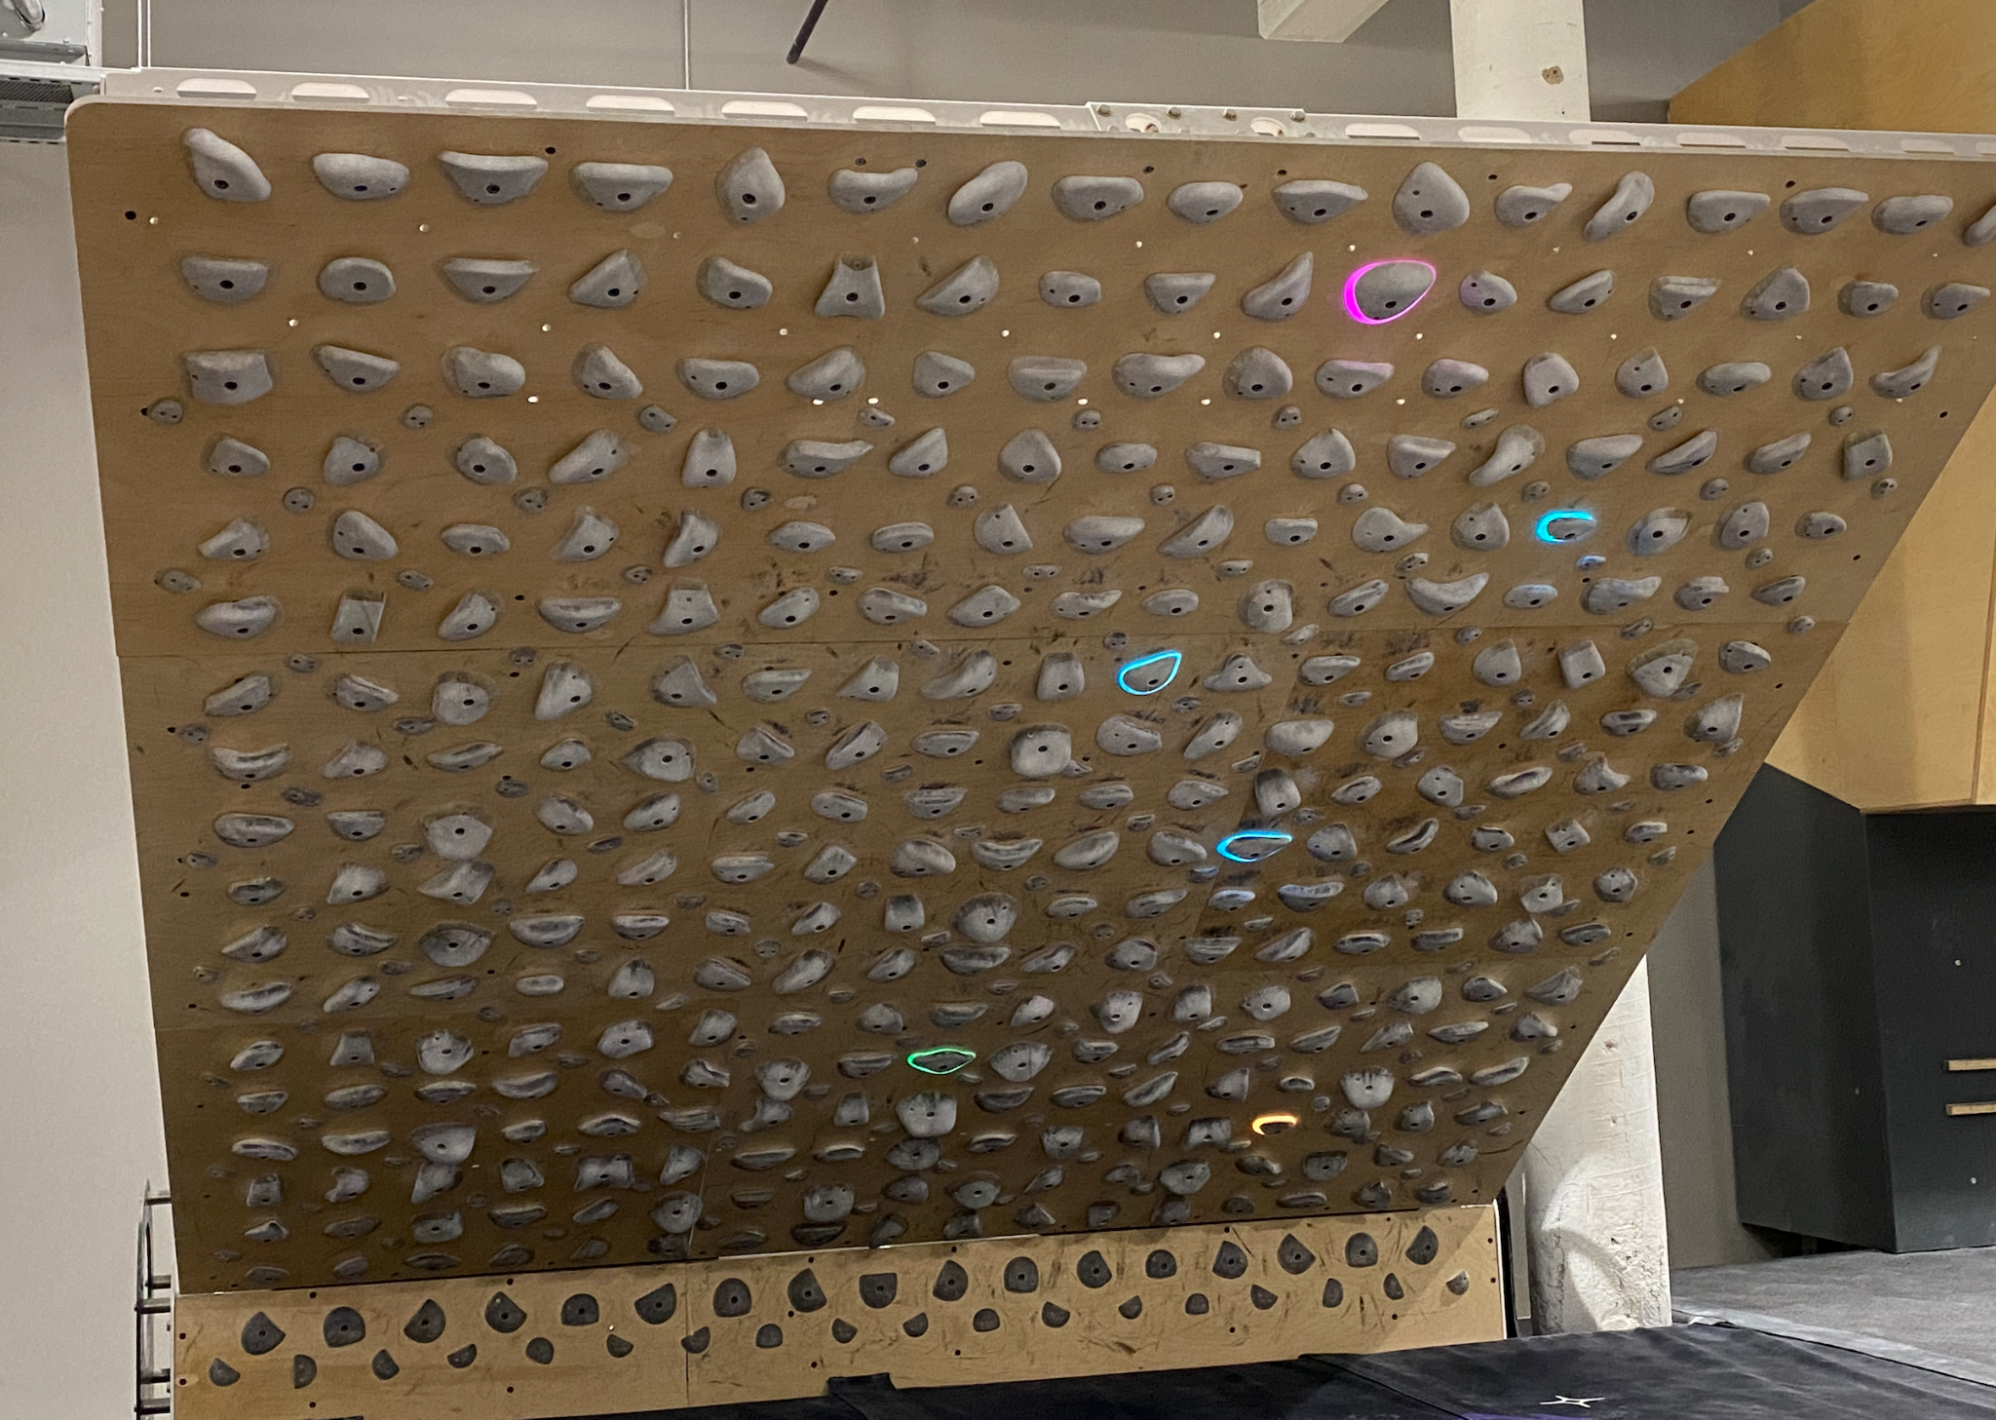
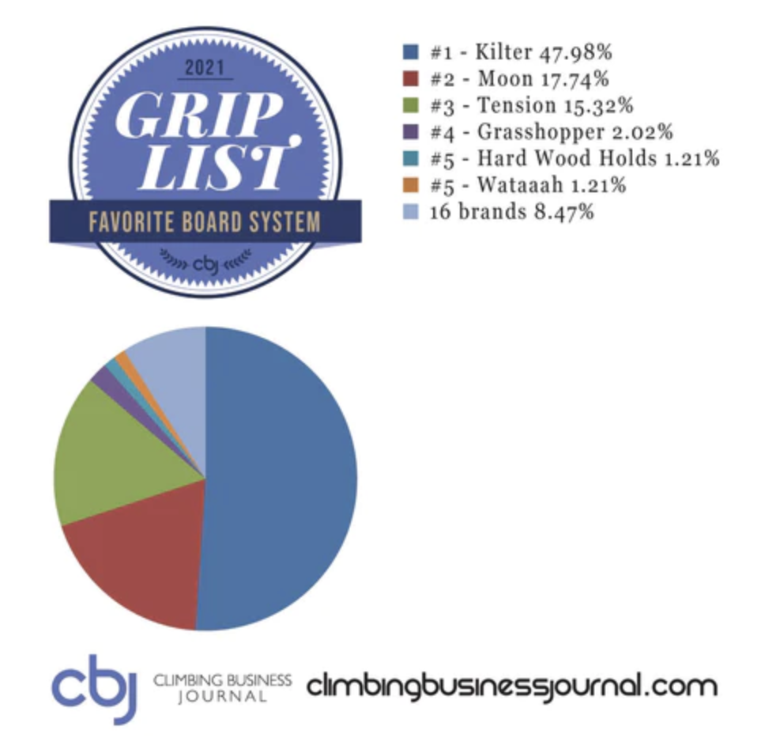

Slide 4
Introduction & Background
Rock climbing
Kilter Board
The problem: Newcomers and shorter climbers often struggle to find suitable betas, leading to a steeper learning curve and potential deterrence from the sport
Current market (KAYA)
Introverted people
Notes:
However, while experienced climbers might easily identify a variety of betas that suit their style and abilities, newcomers often have trouble finding the right beta, particularly when they have yet to fully understand their own climbing strengths and limitations. This problem is more apparent for shorter climbers who might need a more specific beta to progress. Currently, the lack of a centralized platform for climbers to share their betas can significantly hinder the learning curve of newcomers to the sport, sometimes to the point of deterring them from continuing rock climbing. Our proposed application seeks to bridge this gap by providing an interactive community-driven platform where climbers can exchange beta, enabling beginners and shorter climbers to enhance their skills more rapidly and effectively.

Slide 5
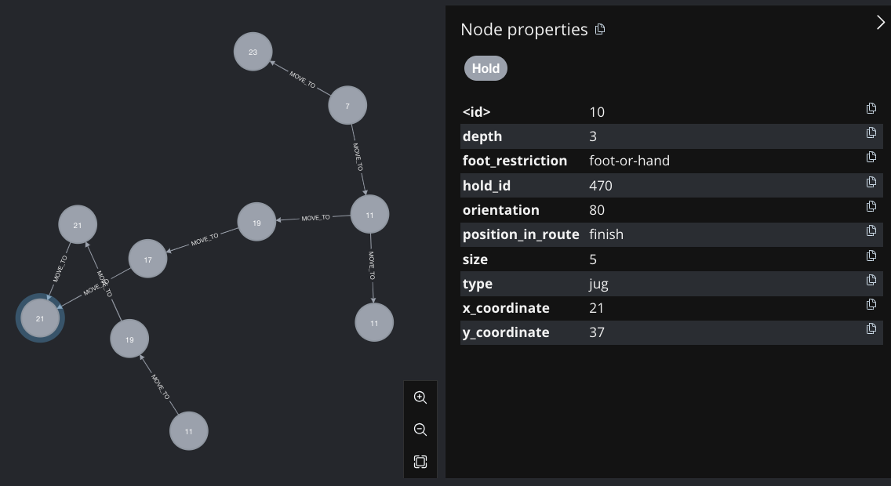
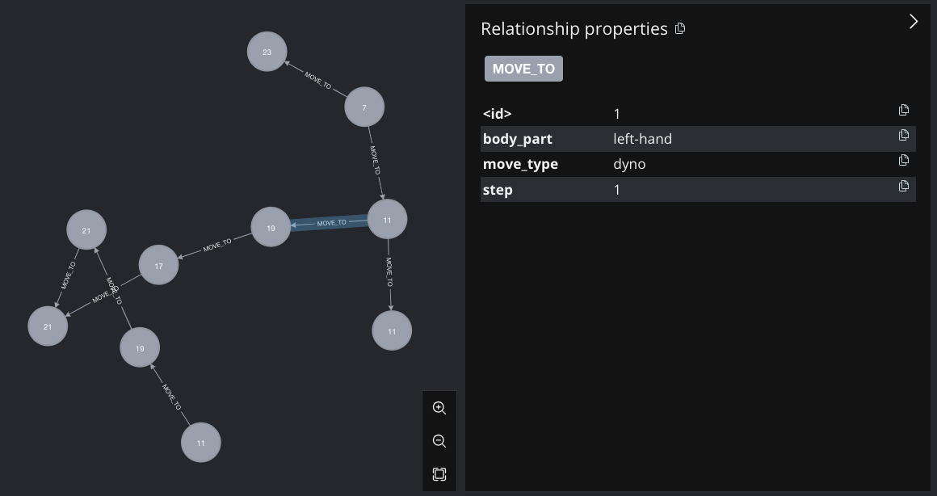
Why Nosql & Neo4j
Postgresql to store relational data
User info
Kilter Board holds info
Nosql
Flexibility for Complex data (non-tabular)
Scalability
Variety of Data (images or even video)
Neo4j: Mapping the climbing wall
Nodes & edges directly represent holds & moves in climbing
Pathfinding Algorithms (Dijkstra’s or A*) to find efficient climbs
Can be easily adapted to new climbing holds & technicals with almost no database changes
Great Visualizations

Slide 6

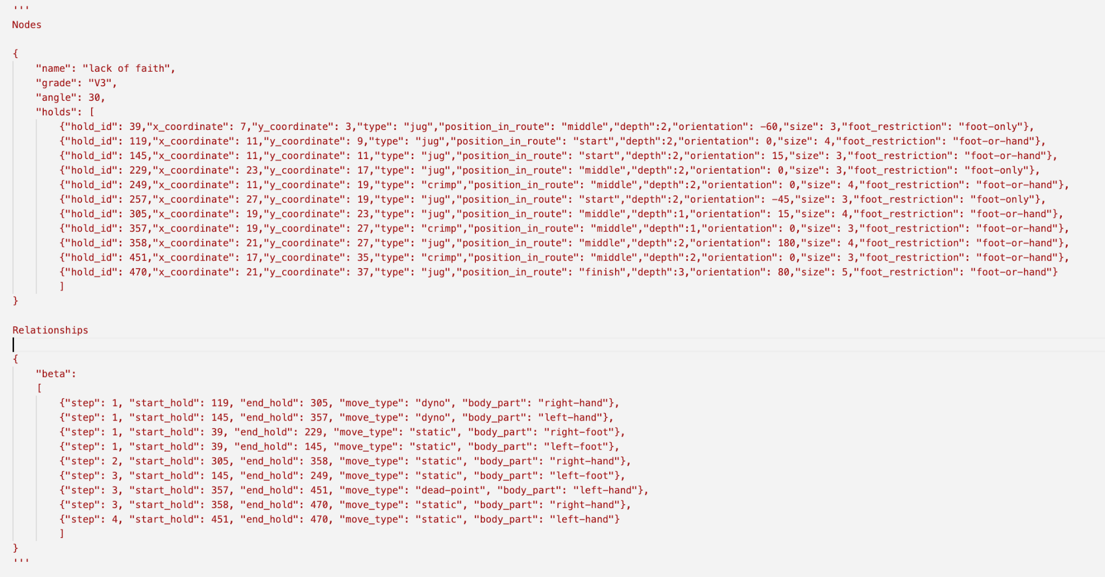
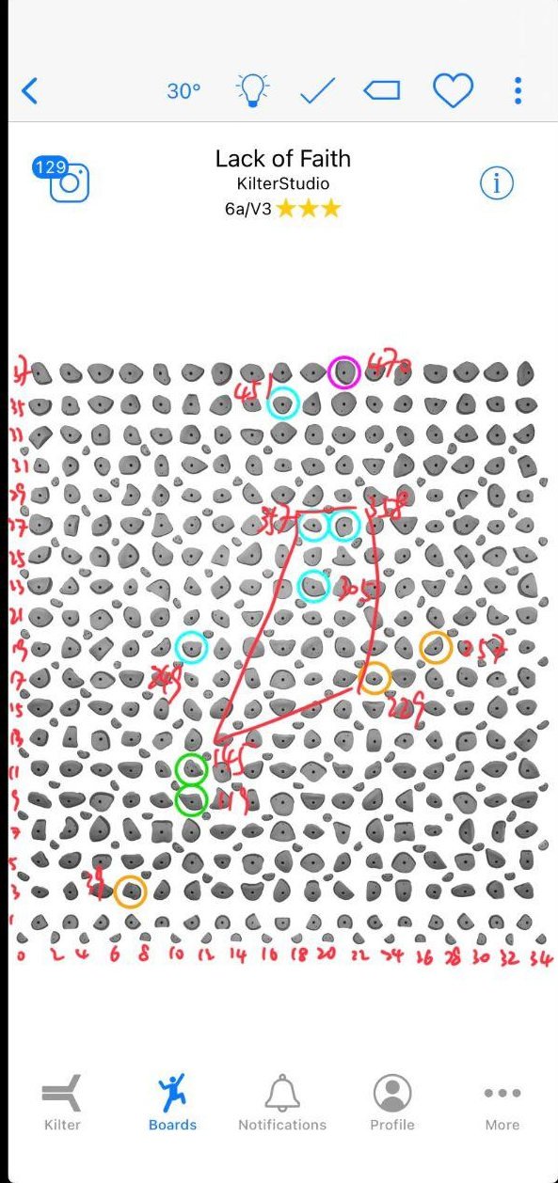
Data
Manual Annotation (Routes + Beta + holds)
30 min/route
Attempts
Webscraping (Mobile App)?
Kilter Board App
Social Media (less structured)
GPT Annotate ?

Slide 7
AI in Rocky Climbing
Fine-tune GPT 3.5 Turbo 1106
Generate Beta in JSON format (can be easily imported into Neo4j)

Slide 8
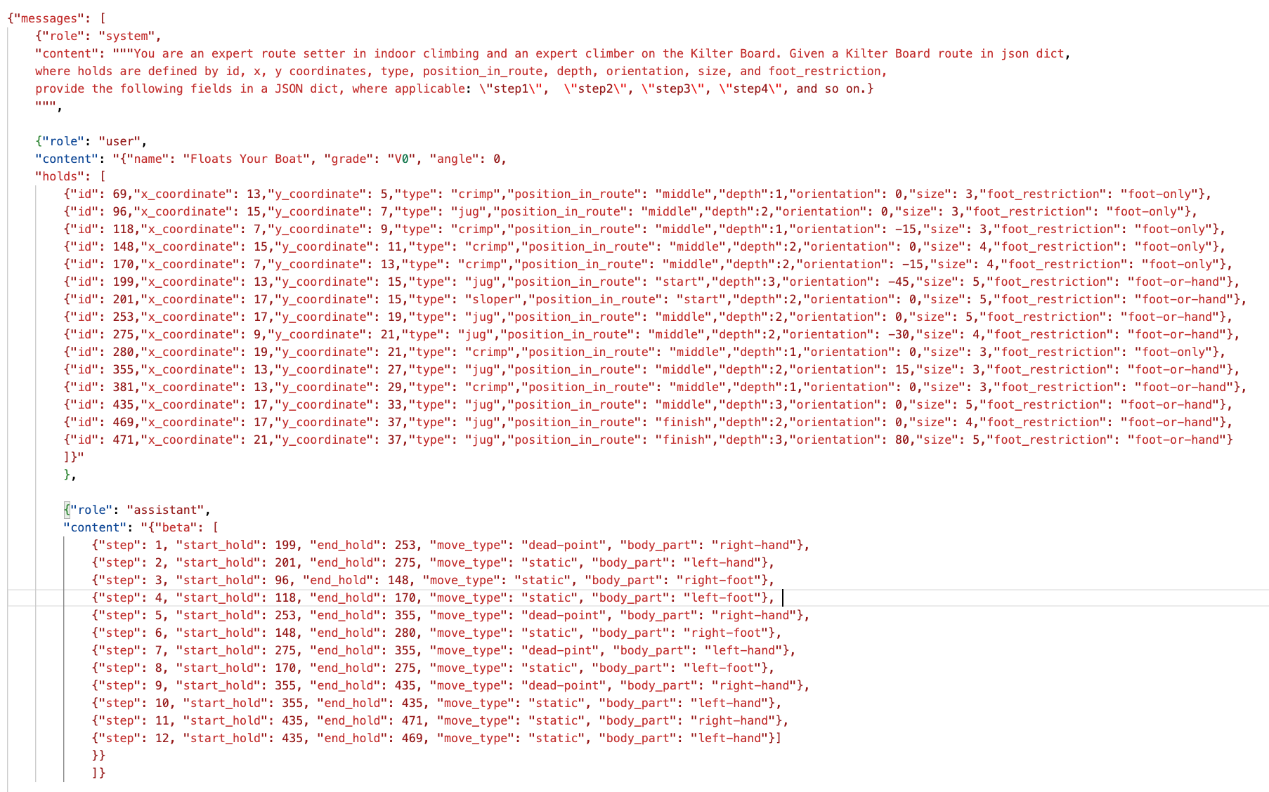

Slide 9
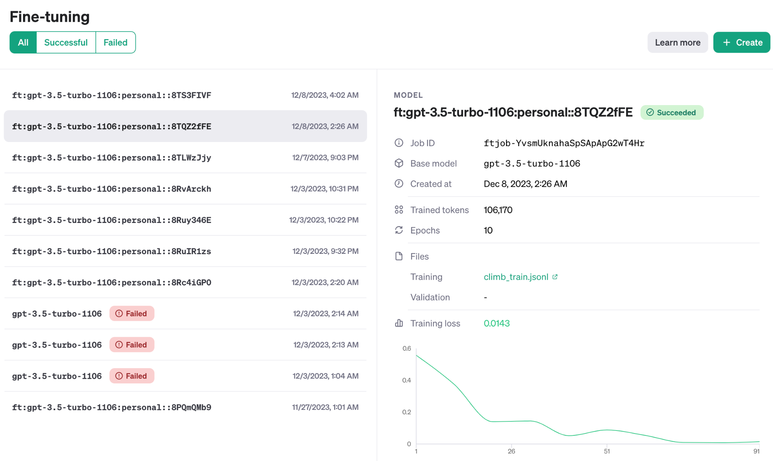

Slide 10
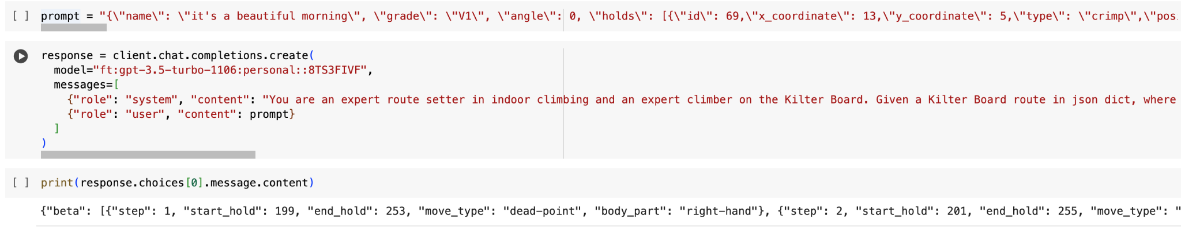
AI in Rocky Climbing

Slide 11

Challenges
Annotation climbing routes & Beta
Not my level
Time
Imagination vs in-person experience
GPT 3.5 vs GPT 4 vs Bard Gemini
Overfitting when fine-tuned on small data
UI & UX Design
Neo4j visualization packages (graph DS)
React & Django (as compared to Flask)

Slide 12
Future Steps
Web-scraping
mobile app
social media (image, video, text)
Community building
Using new models
GPT-4-vision or Gemini for recognizing holds from routes & Annotate
Is it possible to apply to other walls
Better UI & UX Design
as you will see in the following demo
show the beta on our UI
Make an mobile app or website

Slide 13
Live Demo
https://github.com/Rundstedtzz/climbology

Slide 14

Thank you
Q&A

